Slide 1

GCSE: Straight Lines
Dr J Frost (jfrost@tiffin.kingston.sch.uk)
www.drfrostmaths.com
Last modified: 9th October 2016

Slide 2
Contents
Lesson 1: Lines and their equations
Lesson 2: Gradients and midpoints.
Lesson 3: Equations given gradients/points.
Lesson 4: Distance between points and intersections.
Lesson 5: Parallel and perpendicular lines.
Lesson 6: Consolidation.

Slide 3
GCSE specification:
Understand that an equation of the form y = mx + c corresponds to a straight line graph
Plot straight line graphs from their equations
Find the gradient of a straight line graph, using its equation or using two points.
Understand how the gradient of a real life graph relates to the relationship between the two variables
Understand how the gradients of parallel lines are related.
Understand how the gradients of perpendicular lines are related (NEW TO YOU).
Generate equations of a line parallel or perpendicular to a straight line graph.

Slide 4
Part 1
Lines and their Equations

Slide 5


y
What is the equation of this line?
And more importantly, why is it that?
4
3
2
1
-1
-2
-3
-4
x -5 -4 -3 -2 -1 0 1 2 3 4 5 6
$$x=2$$
?
For any point we pick on the line, the $x$ value is always 2.

Slide 6





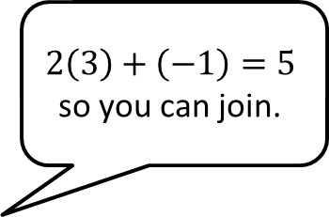
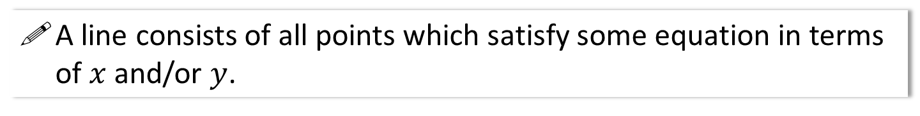
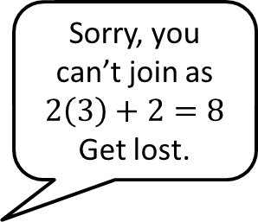

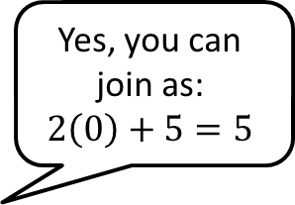

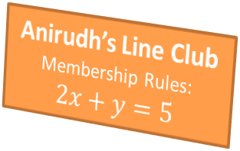
Lines and Equations of Lines
A line consists of all points which satisfy some equation in terms of $x$ and/or $y$.
Sorry, you can’t join as $2\left(3\right)+2=8$
Get lost.
Yes, you can join as:
$$2\left(0\right)+5=5$$
$$2\left(3\right)+\left(−1\right)=5$$
so you can join.
Anirudh’s Line Club
Membership Rules:
$$2x+y=5$$
$$\left(3,2\right)$$
$$\left(0,5\right)$$
$$\left(3,−1\right)$$

Slide 7
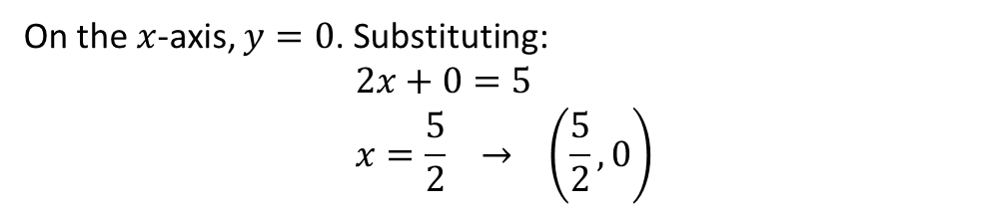

Examples
This means we can substitute the values of a coordinate into our equation whenever we know the point lies on the line.
The point $\left(5,a\right)$ lies on the line with equation $y=3x+2$. Determine the value of $a$.
?
Substituting in $x$ and $y$ value:
$$a=3\left(5\right)+2 \\ a=17$$
Find the coordinate of the point where the line $2x+y=5$ cuts the $x$-axis.
On the $x$-axis, $y=0$. Substituting:
$$2x+0=5 \\ x=\frac{5}{2} → \left(\frac{5}{2}, 0\right)$$
?

Slide 8
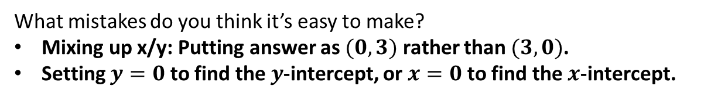
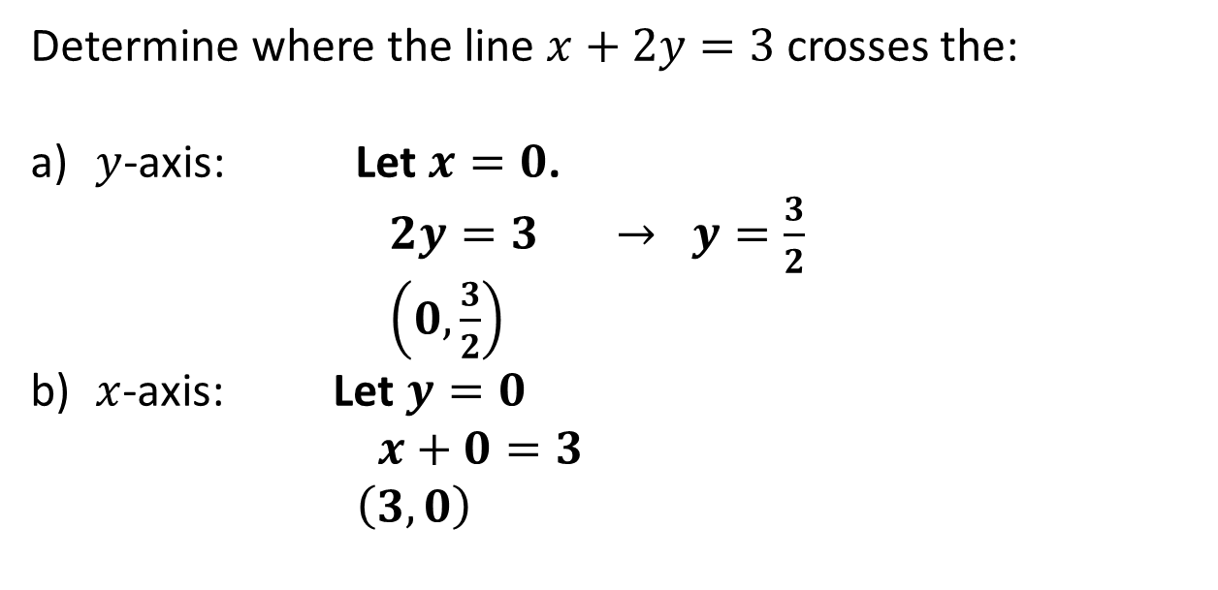
Another intercept example
Determine where the line $x+2y=3$ crosses the:
$y$-axis: Let $x=0$.
$2y=3 → y=\frac{3}{2}$
$\left(0,\frac{3}{2}\right)$
$x$-axis: Let $y=0$
$x+0=3$
$\left(3,0\right)$
?
?
What mistakes do you think it’s easy to make?
Mixing up x/y: Putting answer as $(0,3)$ rather than $(3,0)$.
Setting $y=0$ to find the $y$-intercept, or $x=0$ to find the $x$-intercept.
?

Slide 9
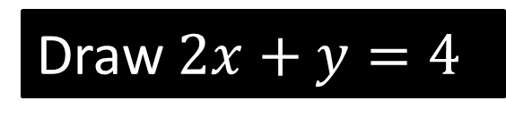
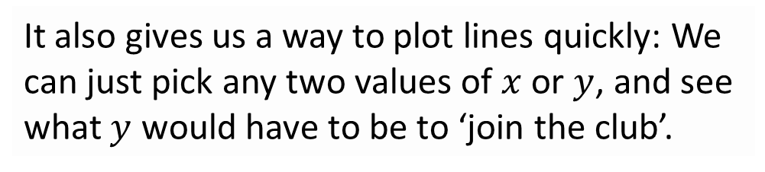

y
Draw $2x+y=4$
4
3
2
1
-1
-2
-3
-4
x -5 -4 -3 -2 -1 0 1 2 3 4 5 6
It also gives us a way to plot lines quickly: We can just pick any two values of $x$ or $y$, and see what $y$ would have to be to ‘join the club’.
?
When $x=0$: $y=4$
When $y=0$: $x=2$
?

Slide 10
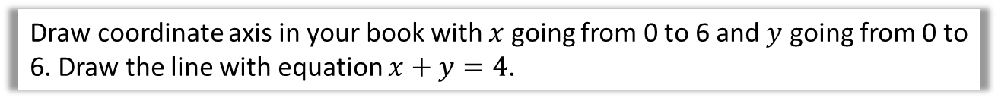
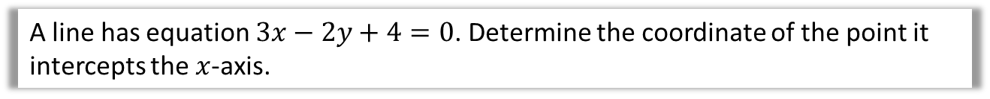
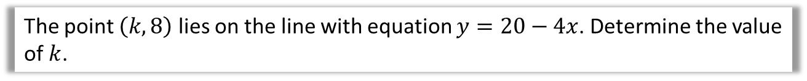
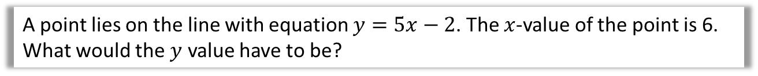


Test Your Understanding
1
A point lies on the line with equation $y=5x−2$. The $x$-value of the point is 6. What would the $y$ value have to be?
?
$$y=5\left(6\right)−2=28$$
2
The point $\left(k,8\right)$ lies on the line with equation $y=20−4x$. Determine the value of $k$.
?
$$8=20−4k \\ 4k=12 \\ k=3$$
3
Draw coordinate axis in your book with $x$ going from 0 to 6 and $y$ going from 0 to 6. Draw the line with equation $x+y=4$.
4
A line has equation $3x−2y+4=0$. Determine the coordinate of the point it intercepts the $x$-axis.
$$3x+4=0 \\ 3x=−4 \\ x=−\frac{4}{3} → \left(−\frac{4}{3}, 0\right)$$
?

Slide 11

(Q3 on previous slide)
y
4
3
2
1
-1
-2
-3
-4
$$x+y=4$$
x -5 -4 -3 -2 -1 0 1 2 3 4 5 6

Slide 12

Exercise 1 – Question 1
y
8
6
4
2
-2
-4
-6
-8
Questions on worksheet provided.
$$x+y=2$$
x -5 -4 -3 -2 -1 0 1 2 3 4 5 6

Slide 13
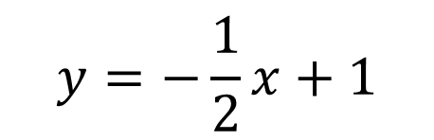
Exercise 1 – Question 2
y
8
6
4
2
-2
-4
-6
-8
$$y=−\frac{1}{2}x+1$$
x -5 -4 -3 -2 -1 0 1 2 3 4 5 6

Slide 14
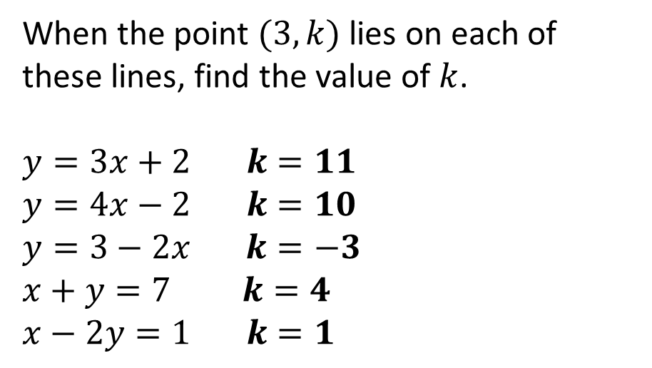
Exercise 1 – Question 3
When the point $(3,k)$ lies on each of these lines, find the value of $k$.
$$y=3x+2 k=11 \\ y=4x−2 k=10 \\ y=3−2x k=−3 \\ x+y=7 k=4 \\ x−2y=1 k=1$$
a
?
b
?
c
?
d
?
e
?

Slide 15
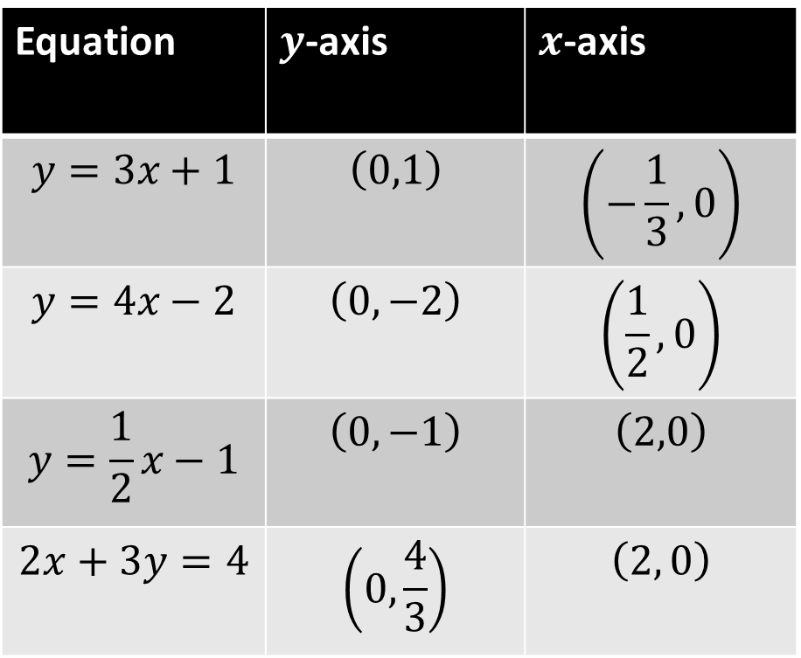
Exercise 1 – Question 4
Copy and complete this table.
The point where the line crosses the:
Equation | $y$-axis | $x$-axis
$$y=3x+1$$ | $$\left(0,1\right)$$ | $$\left(−\frac{1}{3},0\right)$$
$$y=4x−2$$ | $$\left(0,−2\right)$$ | $$\left(\frac{1}{2},0\right)$$
$$y=\frac{1}{2}x−1$$ | $$\left(0,−1\right)$$ | $$\left(2,0\right)$$
$$2x+3y=4$$ | $$\left(0,\frac{4}{3}\right)$$ | $$\left(2, 0\right)$$
?
?
?
?
?
?
?
?

Slide 16
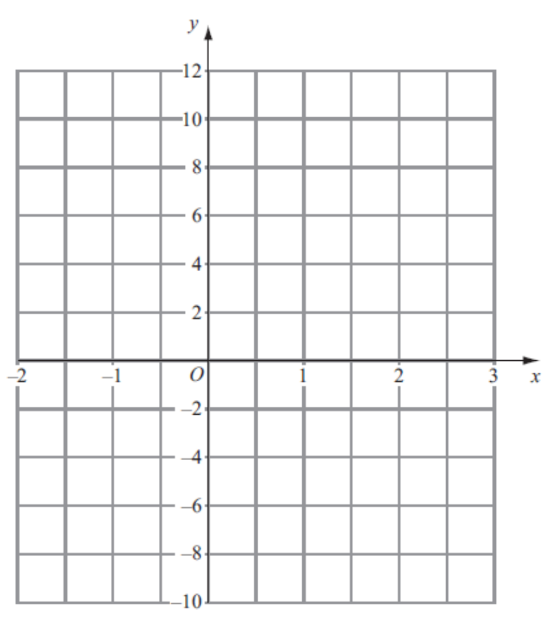

Exercise 1 – Question 5
$$y=4x−2$$

Slide 17
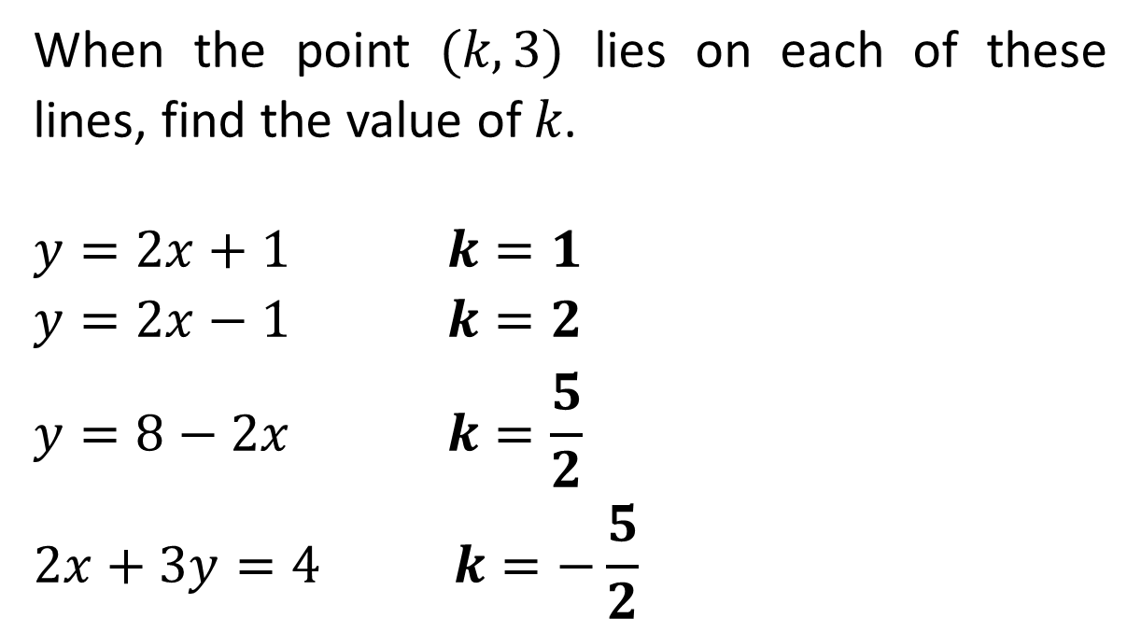
Exercise 1 – Question 6
When the point $(k,3)$ lies on each of these lines, find the value of $k$.
$$y=2x+1 k=1$$
$$y=2x−1 k=2$$
$$y=8−2x k=\frac{5}{2}$$
$$2x+3y=4 k=−\frac{5}{2}$$
?
?
?
?

Slide 18
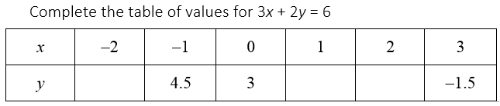
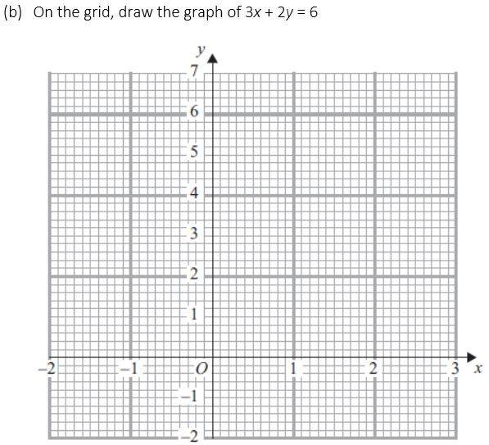
Exercise 1 – Question 7
?
?
?
6 1.5 0
Click to Reveal

Slide 19
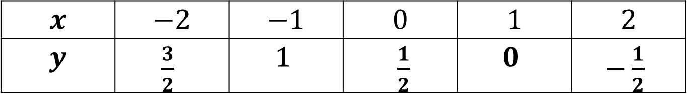
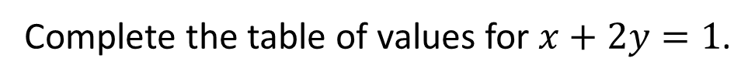
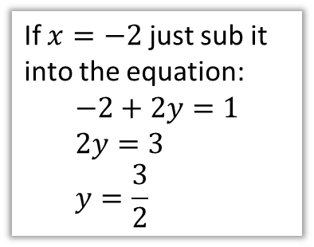
Exercise 1 – Question 8
Complete the table of values for $x+2y=1$.
$$x$$ | $$−2$$ | $$−1$$ | $$0$$ | $$1$$ | $$2$$
$$y$$ | $\frac{3}{2}$ | $$1$$ | $\frac{1}{2}$ | $0$ | $−\frac{1}{2}$
?
?
?
?
If $x=−2$ just sub it into the equation:
$$−2+2y=1 \\ 2y=3 \\ y=\frac{3}{2}$$

Slide 20
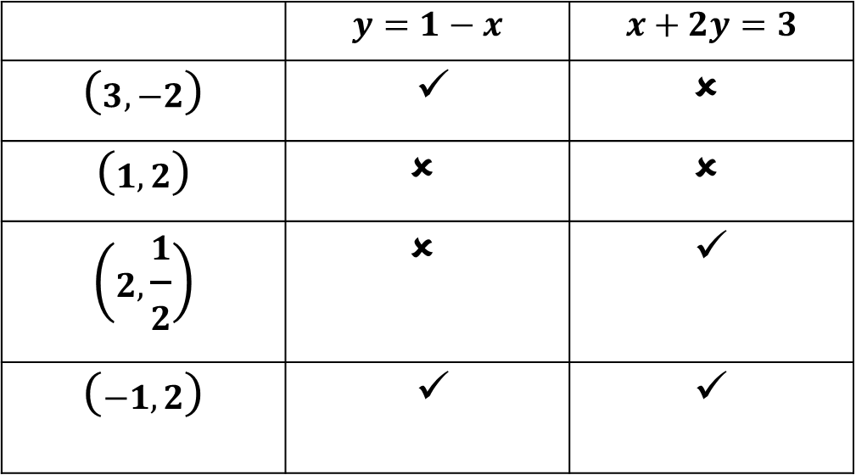
Exercise 1 – Question 9
Put a tick or cross to determine whether each of the following points are on the line with the given equation.
 | $$y=1−x$$ | $$x+2y=3$$
$$\left(3,−2\right)$$ | ✓ | ✗
$$\left(1,2\right)$$ | ✗ | ✗
$$\left(2,\frac{1}{2}\right)$$ | ✗ | ✓
$$\left(−1,2\right)$$ | ✓ | ✓
?
?
?
?
?
?
?
?

Slide 21
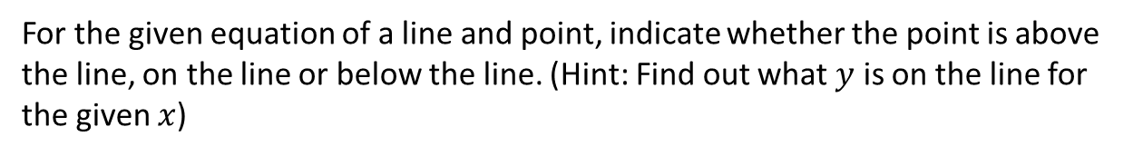
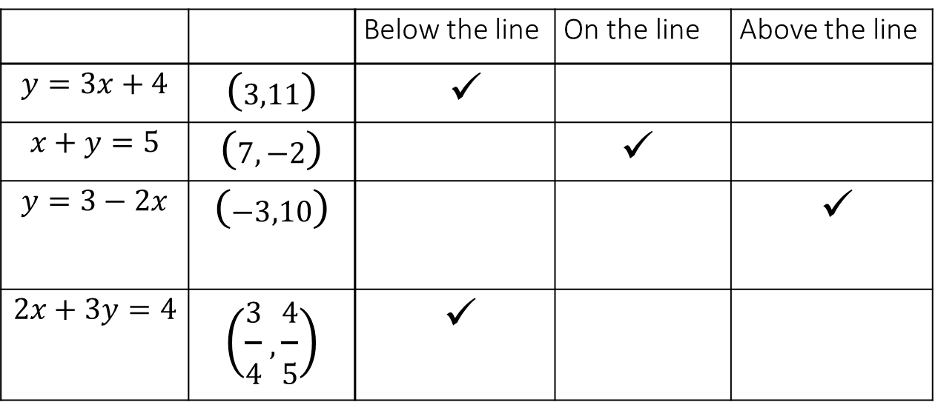
Exercise 1 – Question 10
For the given equation of a line and point, indicate whether the point is above the line, on the line or below the line. (Hint: Find out what $y$ is on the line for the given $x$)
 |  | Below the line | On the line | Above the line
$$y=3x+4$$ | $$\left(3,11\right)$$ | ✓
$$x+y=5$$ | $$\left(7,−2\right)$$ |  | ✓
$$y=3−2x$$ | $$\left(−3,10\right)$$ |  |  | ✓
$$2x+3y=4$$ | $$\left(\frac{3}{4},\frac{4}{5}\right)$$ | ✓
?
?
?
?

Slide 22
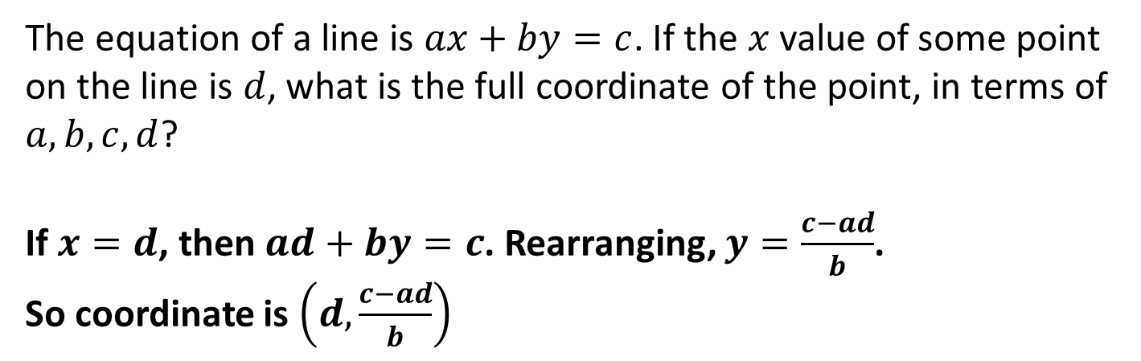
Exercise 1 – Question N₁
The equation of a line is $ax+by=c$. If the $x$ value of some point on the line is $d$, what is the full coordinate of the point, in terms of $a, b, c, d$?
If $x=d$, then $ad+by=c$. Rearranging, $y=\frac{c−ad}{b}$.
So coordinate is $\left(d,\frac{c−ad}{b}\right)$
?

Slide 23
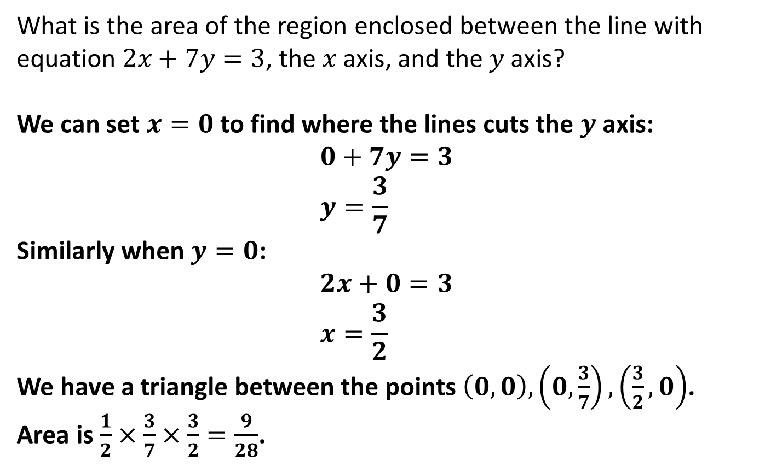
Exercise 1 – Question N₂
What is the area of the region enclosed between the line with equation $2x+7y=3$, the $x$ axis, and the $y$ axis?
We can set $x=0$ to find where the lines cuts the $y$ axis:
$$0+7y=3 \\ y=\frac{3}{7}$$
Similarly when $y=0$:
$$2x+0=3 \\ x=\frac{3}{2}$$
We have a triangle between the points $\left(0,0\right), \left(0,\frac{3}{7}\right), \left(\frac{3}{2},0\right)$.
Area is $\frac{1}{2}×\frac{3}{7}×\frac{3}{2}=\frac{9}{28}$.
?

Slide 24
Part 2
Gradients and midpoints

Slide 25


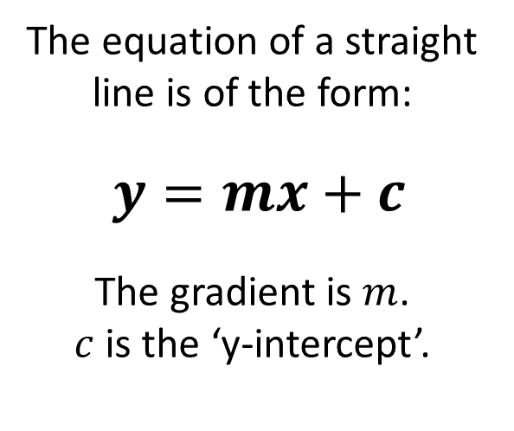
Recap of gradient
The steepness of a line is known as the gradient.
It tells us what $y$ changes by as $x$ increases by 1.
The equation of a straight line is of the form:
$y=mx+c$
The gradient is $m$.
$c$ is the ‘y-intercept’.
Gradient
?
$$1$$

Slide 26
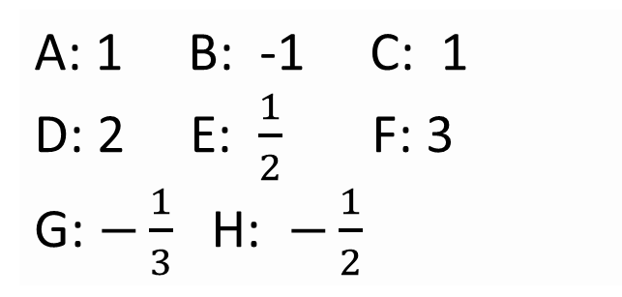
Quickfire Gradient – What is the gradient of each line?
y
4
D
A
3
F
C
2
B
1
G
E
x -5 -4 -3 -2 -1 0 1 2 3 4 5 6
-1
H
-2
?
?
?
A: 1 B: -1 C: 1
D: 2 E: $\frac{1}{2}$ F: 3
G: $−\frac{1}{3}$ H: $−\frac{1}{2}$
-3
?
?
?
?
?
-4

Slide 27
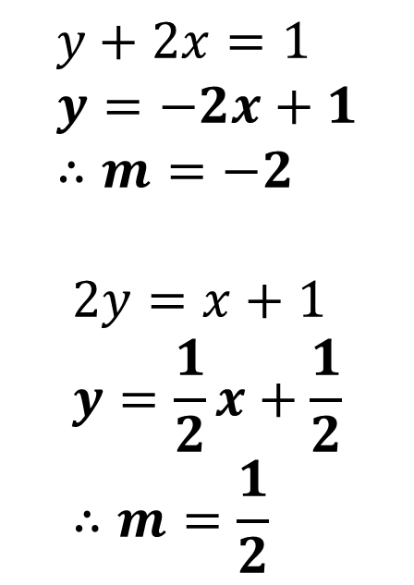
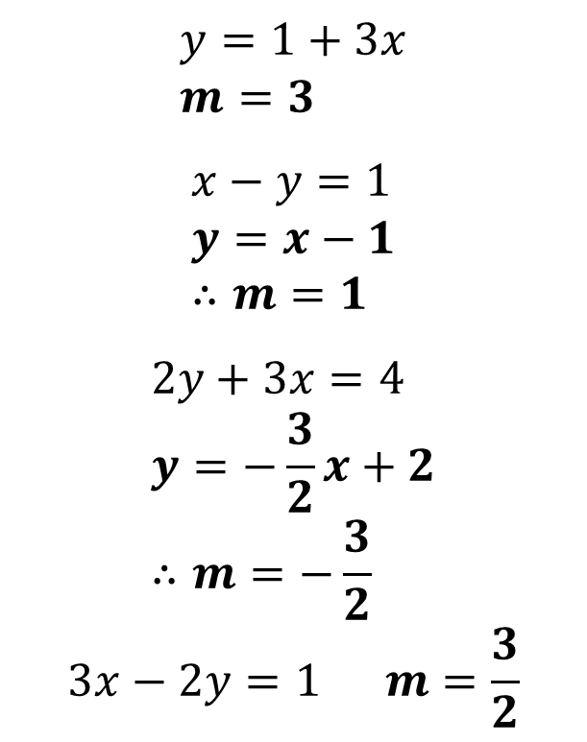
Gradient using the Equation
We can get the gradient of a line using just its equation.
Rearrange into the form $y=mx+c$ (i.e. make $y$ the subject; the gradient is $m$.
Examples
Test Your Understanding
$$y+2x=1 \\ y=−2x+1 \\ ∴m=−2$$
$$2y=x+1 \\ y=\frac{1}{2}x+\frac{1}{2} \\ ∴m=\frac{1}{2}$$
$$y=1+3x \\ m=3$$
$$x−y=1 \\ y=x−1 \\ ∴m=1$$
$$2y+3x=4 \\ y=−\frac{3}{2}x+2 \\ ∴m=−\frac{3}{2}$$
$$3x−2y=1 m=\frac{3}{2}$$
1
?
?
2
?
?
3
?
?
4

Slide 28

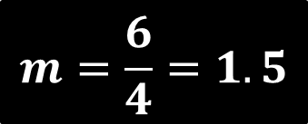

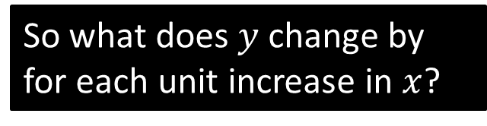
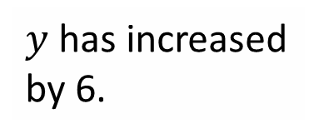
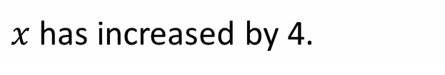
y
$$\left(3, 4\right)$$
Suppose we just had two points on the line and wanted to determine the gradient, but didn’t want to draw a grid.
4
3
2
$y$ has increased by 6.
1
x -5 -4 -3 -2 -1 0 1 2 3 4 5 6
-1
$$\left(−1, −2\right)$$
-2
$x$ has increased by 4.
-3
So what does $y$ change by for each unit increase in $x$?
?
-4
$$m=\frac{6}{4}=1.5$$

Slide 29
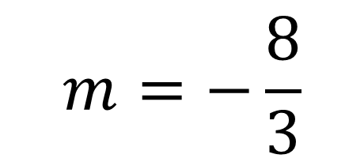

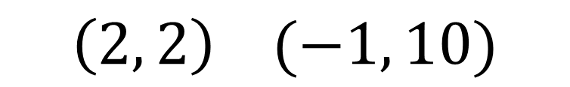
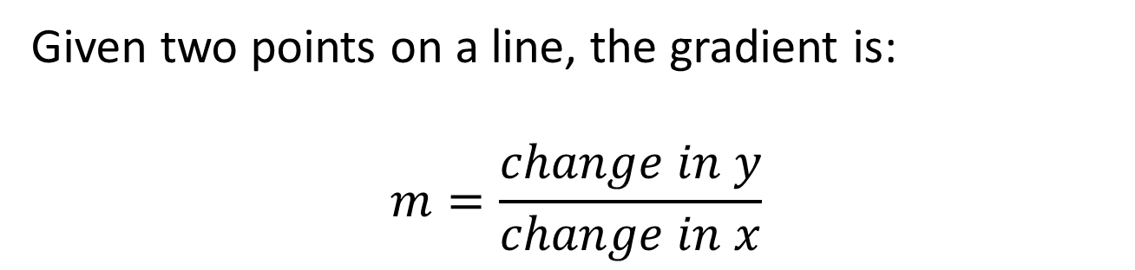
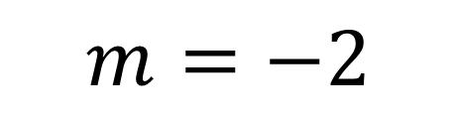


Gradient using two points
!
Given two points on a line, the gradient is:
$$m=\frac{change in y}{change in x}$$
$$\left(1, 4\right) (3, 10)$$
$$m=3$$
?
$$m=−2$$
$$\left(5, 7\right) (8, 1)$$
?
$$m=−\frac{8}{3}$$
$$\left(2, 2\right) (−1, 10)$$
?

Slide 30
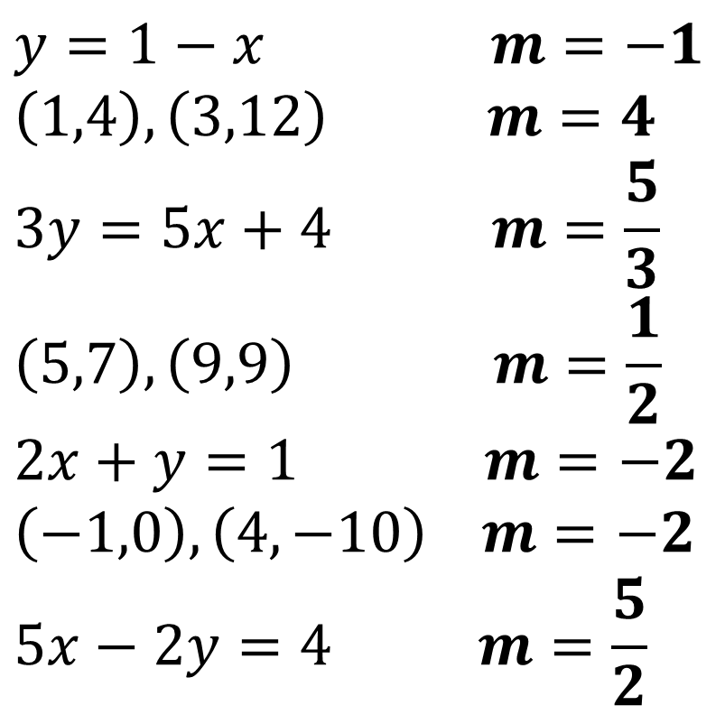
Quickfire Gradients
$$y=1−x m=−1$$
$$\left(1,4\right), \left(3,12\right) m=4$$
$$3y=5x+4 m=\frac{5}{3}$$
$$\left(5,7\right), \left(9,9\right) m=\frac{1}{2}$$
$$2x+y=1 m=−2$$
$$\left(−1,0\right), \left(4, −10\right) m=−2$$
$$5x−2y=4 m=\frac{5}{2}$$
?
?
?
?
?
?
?

Slide 31
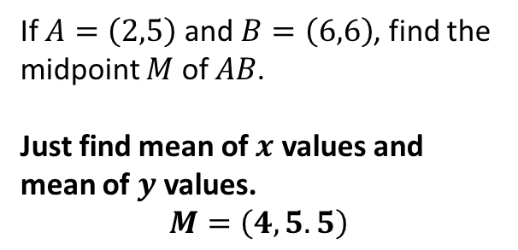






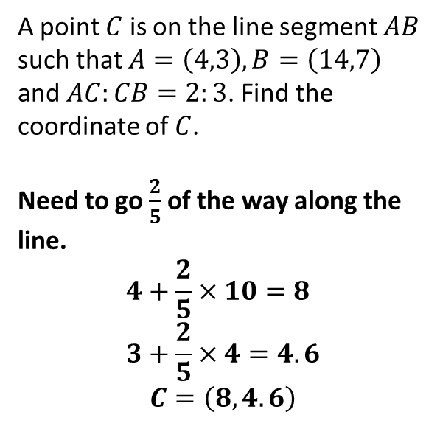
Midpoint of a line segment
$$B$$
$$B$$
$$M$$
$$C$$
$$A$$
$$A$$
A point $C$ is on the line segment $AB$ such that $A=\left(4,3\right), B=\left(14,7\right)$ and $AC:CB=2:3$. Find the coordinate of $C$.
Need to go $\frac{2}{5}$ of the way along the line.
$$4+\frac{2}{5}×10=8 \\ 3+\frac{2}{5}×4=4.6$$
$$C=\left(8, 4.6\right)$$
If $A=\left(2,5\right)$ and $B=\left(6,6\right)$, find the midpoint $M$ of $AB$.
Just find mean of $x$ values and mean of $y$ values.
$$M=\left(4, 5.5\right)$$
?
?

Slide 32
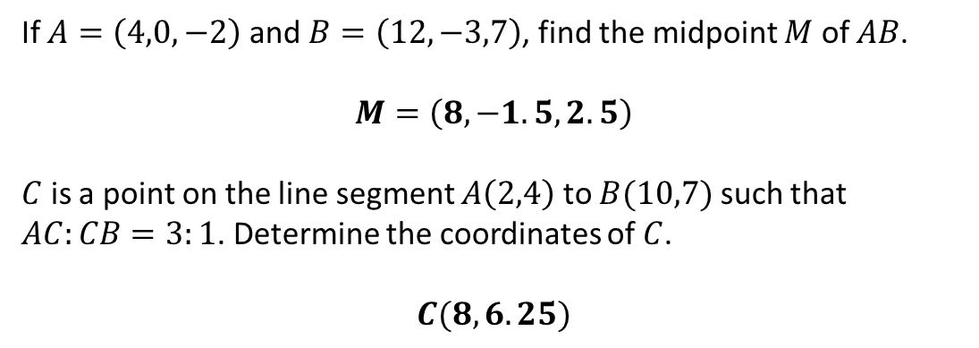
Test Your Understanding
1
If $A=\left(4,0,−2\right)$ and $B=\left(12,−3,7\right)$, find the midpoint $M$ of $AB$.
$$M=\left(8, −1.5, 2.5\right)$$
$C$ is a point on the line segment $A\left(2,4\right)$ to $B(10,7)$ such that $AC:CB=3:1$. Determine the coordinates of $C$.
$$C(8,6.25)$$
?
2
?

Slide 33
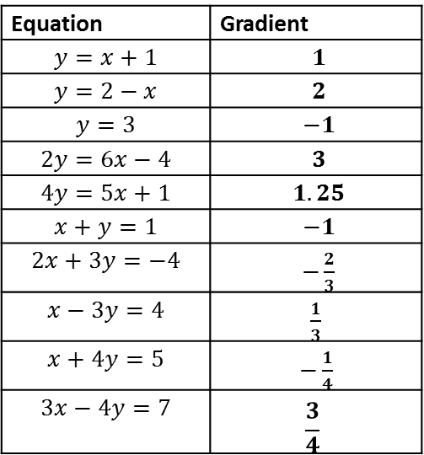
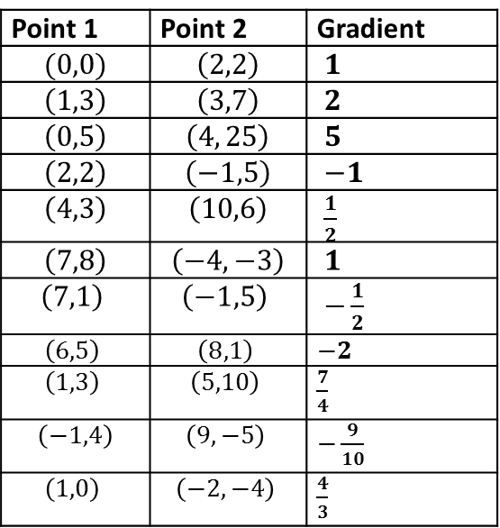
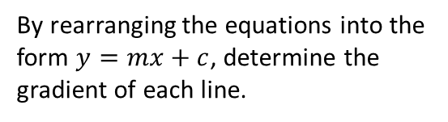
Exercise 2
(On provided sheet)
1
By rearranging the equations into the form $y=mx+c$, determine the gradient of each line.
2
Determine the gradient of the line which goes through the following points.
Point 1 | Point 2 | Gradient
$$(0,0)$$ | $$\left(2,2\right)$$ | $1$
$$\left(1,3\right)$$ | $$\left(3,7\right)$$ | $2$
$$\left(0,5\right)$$ | $$\left(4, 25\right)$$ | $5$
$$\left(2,2\right)$$ | $$\left(−1,5\right)$$ | $−1$
$$\left(4,3\right)$$ | $$\left(10,6\right)$$ | $\frac{1}{2}$
$$\left(7,8\right)$$ | $$\left(−4,−3\right)$$ | $1$
$$\left(7,1\right)$$ | $$\left(−1,5\right)$$ | $−\frac{1}{2}$
$$\left(6,5\right)$$ | $$\left(8,1\right)$$ | $−2$
$$\left(1,3\right)$$ | $$\left(5,10\right)$$ | $\frac{7}{4}$
$$\left(−1,4\right)$$ | $$\left(9,−5\right)$$ | $−\frac{9}{10}$
$$\left(1,0\right)$$ | $$\left(−2,−4\right)$$ | $\frac{4}{3}$
Equation | Gradient
$$y=x+1$$ | $1$
$$y=2−x$$ | $2$
$$y=3$$ | $−1$
$$2y=6x−4$$ | $3$
$$4y=5x+1$$ | $1.25$
$$x+y=1$$ | $−1$
$$2x+3y=−4$$ | $−\frac{2}{3}$
$$x−3y=4$$ | $\frac{1}{3}$
$$x+4y=5$$ | $−\frac{1}{4}$
$$3x−4y=7$$ | $$\frac{3}{4}$$
?
?
?
?
?
?
?
?
?
?
?
?
?
?
?
?
?
?
?
?
?

Slide 34
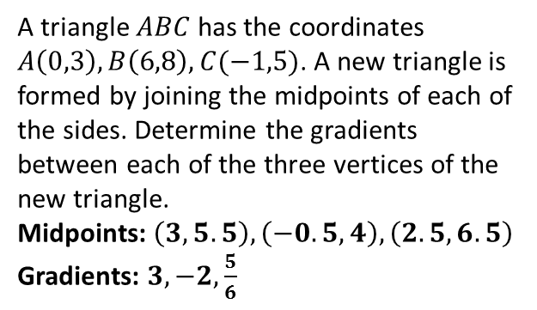
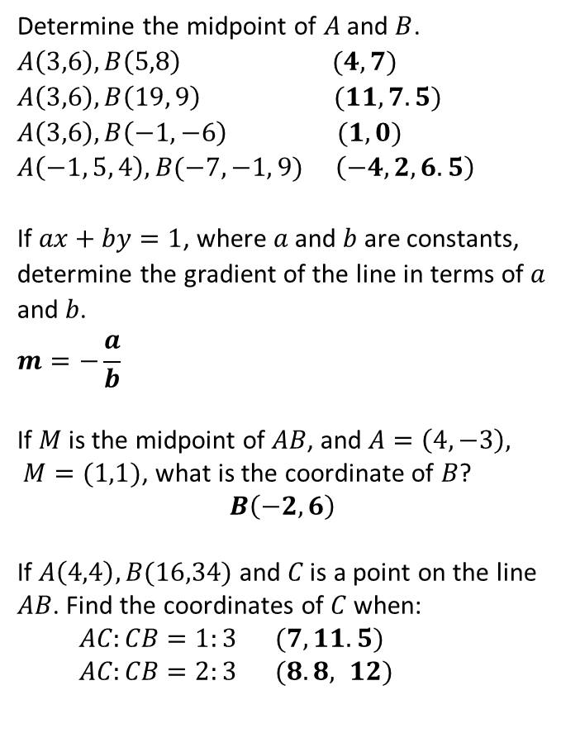
Exercise 2
3
Determine the midpoint of $A$ and $B$.
$A\left(3,6\right), B\left(5,8\right)$ $(4,7)$
$A\left(3,6\right), B\left(19, 9\right)$ $(11,7.5)$
$A\left(3,6\right), B\left(−1, −6\right)$ $(1,0)$
$A\left(−1, 5, 4\right), B(−7, −1, 9)$ $\left(−4, 2, 6.5\right)$
If $ax+by=1$, where $a$ and $b$ are constants, determine the gradient of the line in terms of $a$ and $b$.
$$m=−\frac{a}{b}$$
If $M$ is the midpoint of $AB$, and $A=\left(4,−3\right), M=(1,1)$, what is the coordinate of $B$?
$$B\left(−2,6\right)$$
If $A\left(4,4\right), B(16,34)$ and $C$ is a point on the line $AB$. Find the coordinates of $C$ when:
  $AC:CB=1:3$ $(7, 11.5)$
  $AC:CB=2:3$ $(8.8, 12)$
7
A triangle $ABC$ has the coordinates $A\left(0,3\right), B\left(6,8\right), C(−1,5)$. A new triangle is formed by joining the midpoints of each of the sides. Determine the gradients between each of the three vertices of the new triangle.
Midpoints: $\left(3, 5.5\right), \left(−0.5, 4\right), \left(2.5, 6.5\right)$
Gradients: $3, −2,\frac{5}{6}$
?
?
?
?
4
?
?
5
?
6
?
?

Slide 35







Summary
The gradient of a line is the steepness: how much $y$ changes as $x$ increases by 1.
We’ve seen 3 ways in which we can calculate the gradient:
a. Counting Squares
b. Using the equation
c. Using two points
(but only works if scales on $x$ and $y$ axis are the same)
$$2y=4−5x$$
$$\left(1, 4\right), \left(4, 13\right)$$
$$m=−\frac{5}{2}$$
?
?
?
$$m=−3$$
$$m=3$$

Slide 36
Part 3
Equations given gradients/points

Slide 37

RECAP: Equation of a line
From earlier:
The equation of a straight line is $y=mx+c$
gradient
y-intercept

Slide 38

Examples
E
y
B
A
4
3
2
F
1
A: $y=x−1$
B: $y=2x−1$
C: $y=−\frac{1}{2}x+2$
D: $y=\frac{1}{3}x−2$
E: $y=−3x+1$
F: $y=−\frac{3}{2}x−1$
?
?
?
x -5 -4 -3 -2 -1 0 1 2 3 4 5 6
?
-1
C
?
?
-2
-3
Determine the full equation of each line.
D
-4

Slide 39
Your Turn
y
4
D
A
3
F
C
2
B
1
G
E
x -5 -4 -3 -2 -1 0 1 2 3 4 5 6
-1
H
-2
-3
-4

Slide 40






Getting equation of line using gradient and point
A line with gradient 3 goes through the point $\left(2,5\right)$. Determine the equation of the line in the form
$y=mx+c$.
$$m=3$$
$$\left(2,5\right)$$
‘GCSE’ method
Using gradient, write the formula so far.
$y$-intercept is not yet known.
?
$$y=3x+c$$
$$5=3\left(2\right)+c \\ c=−1 \\ ∴y=3x−1$$
?
Point $(2,5)$ is on the line, so it must satisfy the equation. Use to find $c$.
?

Slide 41




A few more examples
A line has gradient $\left(4,9\right)$ and has gradient 2. What is the equation of the line in the form $y=mx+c$?
$$y=2x+c \\ 9=2\left(4\right)+c \\ c=1 \\ ∴y=2x+1$$
?
Bro Mental Tip: If you know the formula starts with $2x$, find what this is for your $x$ value, then think what you have to ‘adjust’ by to get this to $y$. In this case, $2x$ is 8, so we can see we have to +1 to get to 9.
Quickfire Questions:
(using the mental trick)
Gradient of 2. Goes through $\left(7,11\right)$ → $y=2x−3$
Gradient of 4. Goes through $\left(7,30\right)$ → $y=4x+2$
Gradient of 1. Goes through $\left(7,11\right)$ → $y=x+4$
Gradient of -3. Goes through $\left(2,5\right)$ → $y=−3x+11$
Gradient of $−\frac{1}{2}$. Goes through $\left(4,5\right)$ → $y=−\frac{1}{2}x+7$
?
?
?
?
?

Slide 42


A few more examples
A line $l_{1}$ passes through $\left(3,5\right)$ and $\left(7,7\right)$. What is the equation of the line in the form $ax+by+c=0$, where $a, b, c$ are integers?
?
$$m=\frac{2}{4}=\frac{1}{2} \\ y=\frac{1}{2}x+c \\ 5=\frac{1}{2}\left(3\right)+c \\ c=\frac{7}{2} \\ ∴y=\frac{1}{2}x+\frac{7}{2}$$
We want a form where there are no fractions and 0 is on one side:
$$2y=x+7 \\ x−2y+7=0$$
?

Slide 43





Test Your Understanding
The gradient of a line is $\frac{1}{3}$, and passes through $\left(12,2\right)$. What is the equation of the line, in the form $y=mx+c$.
$$y=\frac{1}{3}x+c \\ 2=\frac{1}{3}\left(12\right)+c \\ c=−2 → y=\frac{1}{3}x−2$$
?
A line $l_{1}$ passes through $\left(6,3\right)$ and $\left(9,2\right)$. Determine the equation of the line in the form $ax+by+c=0$, where $a, b, c$ are integers, and hence determine the coordinate of the point where the line crosses the $x$-axis.
$$m=−\frac{1}{3} \\ y=−\frac{1}{3}x+c \\ 3=−\frac{1}{3}\left(6\right)+c \\ 3=−2+c \\ ∴y=−\frac{1}{3}x+5 \\ 3y=−x+15 \\ x+3y−15=0$$
?
When $y=0$:
$$0=−\frac{1}{3}x+5 \\ \frac{1}{3}x=5 \\ x=15 → \left(15,0\right)$$

Slide 44






Another way (IGCSEFM/C1)
$$\left(x_{1},y_{1}\right)$$
$$\left(x,y\right)$$
For the previous questions, we’ve fixed a particular point on the line (let’s call this $\left(x_{1}, y_{1}\right)$. But we’d still get an equation in terms of $x$ and $y$, representing all the points $(x,y)$ that lie on the line.*
Can we use our approach before to find a more general equation for the line?
?
$$m=\frac{y−y_{1}}{x−x_{1}}$$
! The equation of a straight line with gradient $m$ and goes through $\left(x_{1}, y_{1}\right)$ is
$$y−y_{1}=m\left(x−x_{1}\right)$$
* Bro Note: For this reason, we say that $x_{1}$ and $y_{1}$ are constants, because they are fixed, but $x$ and $y$ are variables because they can vary for a particular straight line as we consider different points on the line.

Slide 45

Quickfire Questions
In a nutshell: You can use this formula whenever you have (a) a gradient and (b) any point on the line.
Gradient | Point | (Unsimplified) Equation
$$3$$ | $$\left(1,2\right)$$ | $$y−2=3(x−1)$$
$$5$$ | $$\left(3,0\right)$$ | $$y=5\left(x−3\right)$$
$$2$$ | $$\left(−3,4\right)$$ | $$y−4=2(x+3)$$
$$\frac{1}{2}$$ | $$\left(1,−5\right)$$ | $$y+5=\frac{1}{2}\left(x−1\right)$$
$$9$$ | $$\left(−4,−4\right)$$ | $$y+4=9\left(x+4\right)$$
?
?
?
?
?
Bro Side Note: I’ve found that many students shun this formula and just use the GCSE method. But you’ll find later on in school it’s common to have algebraic gradients or points, where this new method would be much easier. It’s worth getting used to.

Slide 46


Test Your Understanding
A line $l_{1}$ passes through $\left(7,5\right)$ and $\left(13,2\right)$. Determine the equation of the line in the form $ax+by+c=0$, where $a, b, c$ are integers.
?
$$m=\frac{−3}{6}=−\frac{1}{2}$$
Using the point $\left(7,5\right)$:
$$y−5=−\frac{1}{2}\left(x−7\right) \\ 2y−10=−\left(x−7\right) \\ 2y−10=−x+7 \\ x+2y−17=0$$

Slide 47







Exercise 3
(On provided sheet)
1
Find the equation of the line with the specified gradient which goes through the specified point, leaving your answer in the form $y=mx+c$.
$$\left(4,3\right), m=2 →y=2x−5$$
$$\left(5,20\right), m=3 →y=3x+5$$
$$\left(4,0\right), m=5 →y=5x−20$$
$$\left(4,3\right), m=\frac{1}{2} →y=\frac{1}{2}x+1$$
$$\left(−4,3\right), m=−1 →y=−x−1$$
$$\left(6,4\right), m=−\frac{1}{3} →y=−\frac{1}{3}x+6$$
Do the same, but leave your equations in the form $ax+by+c=0$ where $a, b, c$ are integers. (I advise using the formula)
$$\left(2,3\right), m=4 →4x−y−5=0 \\ \left(5,11\right), m=\frac{1}{2} →x−2y+17=0 \\ \left(7,−2\right),m=\frac{1}{3} →x−3y−13=0 \\ \left(−2,5\right),m=\frac{2}{3} →2x−3y+19=0 \\ \left(4,−1\right),m=\frac{3}{4} →3x−4y−16=0$$
3
Find the equation of the line that goes through the following points, leaving your equation in the form $y=mx+c$.
$$\left(2,3\right), \left(6,7\right) → y=x+1 \\ \left(−1,3\right),\left(4,−7\right) → y=−2x+1 \\ \left(4,5\right),\left(−2,2\right) →y=\frac{1}{2}x+3 \\ \left(3,7\right),\left(9, 5\right) →y=−\frac{1}{3}x+8$$
a
?
b
?
a
?
c
?
b
?
d
?
?
c
e
?
?
f
?
d
4
$$y$$
Determine the equation of this line.
$$y=−\frac{4}{9}x+4$$
2
a
?
$$4$$
?
b
?
c
?
?
$$x$$
d
$$9$$
e
?

Slide 48

Exercise 3
(On provided sheet)
5
A line passes through the points $(2,5)$ and $\left(9, 10\right)$.
a) Find the equation of the line in the form $ax+by+c=0$, where $a,b,c$ are integers. $5x−7y+25=0$
b) Hence determine the coordinate of the point where the line crosses the $x$-axis. $\left(−5,0\right)$
The line $l_{1}$ passes through the points $A(15,11)$ and $B(21,9)$ and intercepts the $y$-axis at the point $C$. The line $l_{2}$ passes through $C$ and $D\left(5,17\right)$. Determine the equation of the line $l_{2}$ in the form $y=mx+c$.
$$y=\frac{1}{5}x+16$$
A line passes through $\left(4,a+13\right), \left(a,4a+1\right)$ for some constant $a$. Determine the gradient of the line.
$$m=\frac{4a+1−a−13}{a−4}=\frac{3a−12}{a−4}=3$$
?
?
6
?
7
?

Slide 49
Part 4
Distances between points and points of intersection

Slide 50








Distances between points
$Δ$ (Greek letter ‘delta’) means “change in”
How could we find the distance between these two points?
Hint: Pythagoras
Form a right-angled triangle using the change in $x$ and change in $y$, then use Pythagoras.
$$(5,9)$$
?
?
$$5$$
?
?
$$Δy=3$$
$$(1,6)$$
?
$$Δx=4$$
! Distance between two points:
$$\sqrt{{\left(Δx\right)}^{2}+{\left(Δy\right)}^{2}}$$

Slide 51


Examples
Distance between:
$(3,4)$ and $\left(5,7\right)$ $\sqrt{2^{2}+3^{2}}=\sqrt{13}$
$(5,1)$ and $\left(6,−3\right)$ $\sqrt{1^{2}+4^{2}}=\sqrt{17}$
$(0,−2)$ and $\left(−1,3\right)$ $\sqrt{1^{2}+5^{2}}=\sqrt{26}$
?
?
Bro Note: Note that unlike with gradient, we don’t care if the difference is positive or negative (it’s being squared to make it positive anyway!)
?
Quickfire Questions:
Distance between:
$(1,10)$ and $\left(4,14\right)$ $\sqrt{3^{2}+4^{2}}=5$
$(3,−1)$ and $\left(0,1\right)$ $\sqrt{3^{2}+2^{2}}=\sqrt{13}$
$(−4,−2)$ and $\left(−12,4\right)$ $\sqrt{8^{2}+6^{2}}=10$
?
?
?

Slide 52


Test Your Understanding So Far…
AQA IGCSEFM June 2012 Paper 2 Q3
?
$$PQ=\sqrt{8^{2}+4^{2}}=8.94$$

Slide 53








Intersection of lines
The diagram shows two lines with equations $y=3x$ and $x+2y=4$, which intersect at the point $P$. The line $OP$ passes through the origin.
Determine the coordinates of $P$.
Just solve two equations simultaneously.
$x+2\left(3x\right)=4$
$7x=4$
$x=\frac{4}{7}$
$y=3\left(\frac{4}{7}\right)=\frac{12}{7}$
b) The line $x+2y=4$ intersects the $x$-axis at the point $Q$. Determine the area of the triangle $OPQ$.
When $y=0, x=4$
Area $=\frac{1}{2}×4×\frac{12}{7}=\frac{24}{7}$
$$y$$
$$y=3x$$
$$P$$
?
$$x+2y=4$$
$$x$$
$$O$$
$$Q$$
?

Slide 54





Further Example
$$y$$
Determine the length of $PQ$.
$$x=8−y \\ 2y=8−y+4 \\ 3y=12 \\ y=4 → x=4 \\ P(4,4)$$
When $x=0$
$$2y=4 \\ y=2 \\ Q(0,2)$$
Distance $PQ$:
$$\sqrt{4^{2}+2^{2}}=\sqrt{20}$$
$$2y=x+4$$
?
$$P$$
$$Q$$
$$x+y=8$$
$$x$$
$$O$$

Slide 55







Test Your Understanding
$$y$$
a) Determine the coordinate of $P$.
$$2\left(x−3\right)+x=12 \\ x=6 → y=3$$
b) Determine the area of $PQR$.
$$R\left(0,−3\right) \\ Q\left(0,6\right) \\ Area=\frac{1}{2}×9×6=27$$
c) Determine the length $PQ$.
$$P\left(6,3\right), Q\left(0,6\right) \\ Dist=\sqrt{6^{2}+3^{2}}=\sqrt{45}$$
$$Q$$
$$2y+x=12$$
$$y=x−3$$
?
$$P$$
?
$$O$$
$$x$$
?
$$R$$

Slide 56










Exercise 4
(On provided sheet)
1
Find the coordinate of the point of intersection between these lines:
$y=x+5,$ $y=2x$ $→ \left(5,10\right)$
$y=2x−5,$ $y=x+5$ $→ \left(10,15\right)$
$x+y=5,$ $y=2x−4$ $→ \left(3,2\right)$
$2x+y=7,$ $x−2y=6$ $→ \left(4,−1\right)$
$4x+3y=1,$ $y=1−x$ $→ \left(−2,3\right)$
Find the distance: (giving exact values)
3
Find the distance between the two points where $y=3x+12$ crosses the coordinate axes.
$$\left(0,12\right),\left(−4,0\right) → 4\sqrt{10}$$
Line $l_{1}$ passes through $\left(−1,1\right)$ and $\left(6,15\right)$. Another line $l_{2}$ passes through $(0,−12)$ and $\left(3,3\right)$. Determine the coordinate of the point at which they intersect.
$$l_{1}:y=2x+3, l_{2}:y=5x−12 \\ \left(5,13\right)$$
Line $l_{1}$ has the equation $y=x$ and $l_{2}$ has the equation $y=−2x+12$. The two lines intersect at point $A$ and line $l_{2}$ intersects the $x$ and $y$-axis at $B$ and $C$ respectively, as indicated. Find the area of:
$OAB$ (where $O$ is the origin) $12$
$OAC$ $24$
a
?
?
b
?
c
?
4
d
?
e
?
2
?
$$y$$
$$B(6,5)$$
5
$$E(−3,3)$$
$$A(2,4)$$
$$x$$
$$C(5,0)$$
?
$$D(0,−12)$$
?
?
?
a
$AB=\sqrt{17}$ $AC=5$
$CD=13$ $DE=\sqrt{234}$
$$CE=\sqrt{73}$$
b
c
?
d
?
e
?

Slide 57


Exercise 4
(On provided sheet)
6
[AQA IGCSEFM Jan 2013 Paper 1 Q16]
$A, B$ and $C$ are points on the line
$2x+y=8$.
$DCE$ is a straight line.
$$AB:BC=2:1 \\ EC:CD=1:2$$
Work out the ratio:
$$Area of triangle AEC$$
$:Area of triangle BCD$
Give your answer in its simplest form.
$$A\left(4,0\right), B\left(0,8\right) ∴C\left(−2,12\right)$$
Again using ratios provided:
$$E\left(−3,0\right), D\left(0,36\right)$$
Area of $AEC=\frac{1}{2}×7×12=42$
Area of $BCD=\frac{1}{2}×28×2=28$
Ratio: $42:28=3:2$
?

Slide 58
Part 5
Perpendicular and parallel lines

Slide 59




y
4
3
2
1
-1
-2
-3
-4
$$m=\frac{1}{2}$$
?
?
$$m=3$$
x -5 -4 -3 -2 -1 0 1 2 3 4 5 6
?
$$m=3$$
$$m=\frac{1}{2}$$
?
Find the gradients of each pair of parallel lines. What do you notice?

Slide 60
y
4
3
2
1
-1
-2
-3
-4
m = -1/3
m = 1/2
?
?
m = 3
?
x -5 -4 -3 -2 -1 0 1 2 3 4 5 6
m = -2
?
Find the gradients of each pair of perpendicular lines. What do you notice?

Slide 61

Perpendicular Lines
!
The gradients of parallel lines are equal.
If two lines are perpendicular, then the gradient of one is the negative reciprocal of the other.
$$m_{1}=−\frac{1}{m_{2}}$$
To show that two lines are perpendicular:
$$m_{1}m_{2}=−1$$
Gradient | Gradient of Perpendicular Line
$$2$$ | $$−\frac{1}{2}$$
$$−3$$ | $$\frac{1}{3}$$
$$\frac{1}{4}$$ | -4
$$5$$ | $$−\frac{1}{5}$$
$$−\frac{2}{7}$$ | $$\frac{7}{2}$$
$$\frac{7}{5}$$ | $$−\frac{5}{7}$$
?
?
?
?
?
?

Slide 62
Example Problems
1
A line is goes through the point (9,10) and is perpendicular to another line with equation $y=3x+2$. What is the equation of the line?
$$y−10=−\frac{1}{3}\left(x−9\right)$$
A line $L_{1}$ goes through the points $A\left(1,3\right)$ and $B\left(3,−1\right)$. A second line $L_{2}$ is perpendicular to $L_{1}$ and passes through point B. Where does $L_{2}$ cross the x-axis?
$$\left(5,0\right)$$
Are the following lines parallel, perpendicular, or neither?
$$y=\frac{1}{2}x$$
$$2x−y+4=0$$
Neither. Gradients are $\frac{1}{2}$ and $2$. But $\frac{1}{2}×2=1$, not -1, so not perpendicular.
?
2
?
3
?

Slide 63



Putting in the form $ax+by=c$ or $ax+by+c=0$
Sometimes a question might ask you to put your equation in a particular form.
…Leave your answer in the form $ax+by=c$, where $a,b,c$ are integers.
$$y=\frac{1}{2}x−2 \\ 2y=x−4 \\ x−2y=4$$
We want whole numbers not fractions, so what should we do to both sides of the equation?
?
?
I tend to put everything on the side that makes $x$ positive, but it doesn’t hugely matter.
…Leave your answer in the form $ax+by+c=0$, where $a,b,c$ are integers.
$$y=\frac{2}{3}x+4 \\ 3y=2x+12 \\ 2x−3y+12=0$$
?

Slide 64







Test Your Understanding
1
A line is goes through the point (4,7) and is perpendicular to another line with equation $y=2x+2$. What is the equation of the line? Put your answer in the form $ax+by+c=0$, where $a,b,c$ are integers.
$$y=−\frac{1}{2}x+9 \\ 2y=−x+18 \\ x+2y−18=0$$
2
Determine the point $A$.
$$y$$
$$A$$
$$y=−\frac{1}{2}x+4$$
?
$$x$$
?
Equation of other line: $y=2x$
$$2x=−\frac{1}{2}x+4 \\ 4x=−x+8 \\ 5x=8 →x=\frac{8}{5} \\ y=2×\frac{8}{5}=\frac{16}{5}$$

Slide 65






Exercise 5
(On provided sheet)
1
Are the following lines parallel, perpendicular or neither?
$y=2x+3, y=2x$ Parallel
$y=3x−4, y=−3x+1$ Neither
$y=\frac{1}{2}x+1, y=−2x$ Perpendicular
A line is parallel to $y=2x+3$ and goes through the point $\left(4,3\right)$. What is its equation?
$$y=2x−5$$
A line $l_{1}$ goes through the indicated point and is perpendicular to another line $l_{2}$. Determine the equation of $l_{1}$ in each case.
$$\left(2,5\right) l_{2}:y=2x+1 l_{1}:y=−\frac{1}{2}x+6 \\ \left(−6,3\right) l_{2}:y=3x l_{1}:y=−\frac{1}{3}x+1 \\ \left(0,6\right) l_{2}:y=−\frac{1}{2}x−1 l_{1}:y=2x+6 \\ \left(−9,0\right) l_{2}:y=−\frac{1}{3}x+1 l_{1}:y=3x+27 \\ \left(10,10\right) l_{2}:y=−5x+5 l_{1}:y=\frac{1}{5}x+8$$
4
$$A\left(2,5\right) B\left(4,9\right)$$
Find the equation of the line which passes through B, and is perpendicular to the line passing through both A and B.
$$y=−\frac{1}{2}x+11$$
Line $l_{1}$ has the equation $2y+3x=4$. Line $l_{2}$ goes through the points $(2,5)$ and $(5,7)$. Are the lines parallel, perpendicular, or neither?
$$m_{1}=−\frac{3}{2} m_{2}=\frac{2}{3}$$
$m_{1}m_{2}=−1$ so perpendicular.
?
?
?
?
2
5
?
3
?
?
?
6
$$l$$
?
$$y=3x+5$$
?
$$x$$
?
Determine the equation of the line $l$.
$$y=−\frac{1}{3}x+5$$
?

Slide 66








Exercise 5
(On provided sheet)
$$y$$
[AQA IGCSEFM June 2012 Paper 1 Q11] $OABC$ is a kite.
7
9
$$y=−2x+4$$
$$l$$
$$x$$
Determine the equation of the line $l$.
Known point on $l$:
$$\left(2,0\right)$$
So equation of $l$:
$$y=\frac{1}{2}x−1$$
?
$$A\left(3,7\right), B\left(5,13\right)$$
Find the equation of the line passing through $B$ and is perpendicular to the line passing through $A$ and $B$, giving your answer in the form $ax+by+c$, where $a,b,c$ are integers.
$$y−13=−\frac{1}{3}\left(x−5\right) \\ 3y−39=−\left(x−5\right) \\ x+3y−43$$
a) Work out the equation of $AC$.
$$y=−\frac{1}{3}x+4$$
b) Work out the coordinates of $B$.
Intersection of $y=3x$ and $y=−\frac{1}{3}x+4:$
$3x=−\frac{1}{3}x+4 → 9x=−x+12$
$$x=1.2, y=3.6 \\ B\left(2.4, 7.2\right)$$
8
?
?
?

Slide 67

Exercise 5
(On provided sheet)
N
Suppose $O$ is the origin, and $A\left(1,2\right), B\left(4,2\right), C(2.2, −0.4)$.
Prove that $OABC$ is a kite.
(Hint: you need to prove two things as part of this.)
a) Prove that $OB$ is perpendicular to $AC$:
$$m_{OB}=\frac{2}{4}=\frac{1}{2} \\ m_{AC}=\frac{−2.4}{1.2}=−2$$
$\frac{1}{2}×−2=−1∴$ perpendicular.
b) Prove that $AX=XC$ where $X$ is the point of intersection of the two ‘diagonals’ $OB$ and $AC$, i.e. the quadrilateral has a line of symmetry.
Equation of $OB$: $y=\frac{1}{2}x$
Equation of $AC:$ $y=−2x+4$
$$\frac{1}{2}x=−2x+4 → X(1.6, 0,8)$$
$$AX=\sqrt{0.6^{2}+1.2^{2}}=\frac{3}{\sqrt{5}} \\ XC=\sqrt{0.6^{2}+1.2^{2}}=\frac{3}{\sqrt{5}}$$
$∴AX=XC$ and thus the kite has a line of symmetry.
?

Slide 68


Exercise 6 – Mixed Exercises
(On provided sheet)
1
Line $l_{1}$ passes through the points $\left(4,5\right)$ and $\left(7,11\right)$. Line $l_{2}$ has the equation $2y=3x−1$. Do the lines intersect?
$m_{1}=\frac{6}{3}=2$ but $m_{2}=\frac{3}{2}$. Since $2≠\frac{3}{2}$, the lines are not parallel and thus must intersect.
$A$ is the point $\left(4,−1\right)$ and $B$ is the point $\left(7,7\right)$.
a) Find the coordinates of the midpoint of $AB$.
$$\left(5.5, 3\right)$$
b) Find the distance $AB$ to 2 dp.
$$\sqrt{3^{2}+8^{2}}=\sqrt{73}=8.54$$
Line $l_{1}$ has the equation $y=2x+1$ and line $l_{2}$ the equation $y=4x−3$. Find the coordinates of the point at which they intersect.
$$2x+1=4x−3 →x=2 \\ \left(2,5\right)$$
4
a) Find the gradient of the line with equation $3x−4y=12$.
$$m=\frac{3}{4}$$
b) Prove that $3x−4y=12$ and
$3y=12−4x$ are perpendicular.
$$\frac{3}{4}×−\frac{4}{3}=−1∴perpendicular$$
A line passes through the points $\left(0,4\right)$ and $\left(6,1\right)$. Find the equation of the line in the form:
$y=mx+c$ $→y=−\frac{1}{2}x+4$
$ax+by=c$ where $a,b,c$ are integers.
$x+2y=8$
Find the coordinates of the points where $2x−3y=6$ crosses:
The $x$-axis. $\left(3,0\right)$
The $y$-axis. $\left(0,−2\right)$
?
?
?
2
5
?
?
?
3
?
6
?
?
?

Slide 69







Exercise 6 – Mixed Exercises
(On provided sheet)
7
[Edexcel]
8
$$y$$
$$5$$
$$x$$
$$4$$
Determine the equation of this line, putting your answer in the form $ax+by+c=0$, where $a,b,c$ are integers.
$$y=−\frac{5}{4}x+5$$
$ABCD$ is a square. $P$ and $D$ are points on the $y$-axis. $A$ is a point on the $x$-axis. $PAB$ is a straight line. The equation of the line that passes through the points $A$ and $D$ is $y=−2x+6$. Find the length of $PD.$
Point $A$: $(3,0)$. Point $D$: $\left(0,6\right)$
Equation of $AB$: $y=\frac{1}{2}x−\frac{3}{2}$
Therefore $P\left(0,−\frac{3}{2}\right)$
$$PD=\frac{3}{2}+6=7.5$$
?
?

Slide 70

Exercise 6 – Mixed Exercises
(On provided sheet)
9
A triangle consists of the points $P(3,k)$, $Q\left(6,8\right)$ and $R\left(10,10\right)$. $PQR$ is a right angle.
Determine the equation of the line passing through $P$ and $R$, leaving your answer in the form $ax+by=c$, where $a,b,c$ are integers.
Gradient of line passing through $QR$:
$$m=\frac{1}{2}$$
Equation of $PQ$:
$$y=−2x+20$$
Therefore:
$$k=−2\left(3\right)+20=14$$
Equation of $PR$:
$$y−14=−\frac{4}{7}\left(x−3\right) \\ 7y−98=−4\left(x−3\right) \\ 7y−98=−4x+12 \\ 4x+7y=110$$
?

