Slide 1
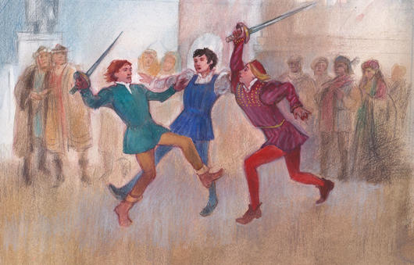
To Whoosh! R&J
Stop in the name of love!
He started it!
But he bit his thumb at me!
WHOOSH!

Slide 2
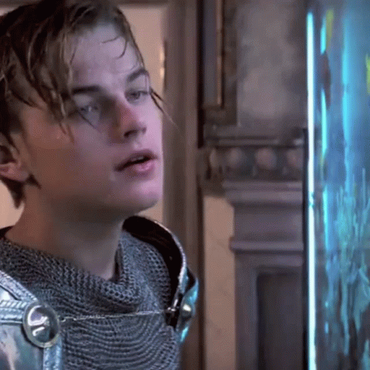
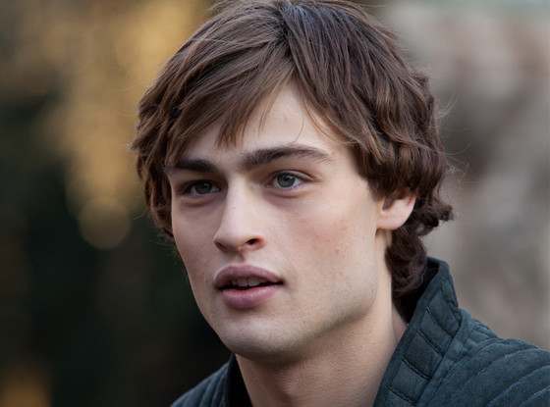
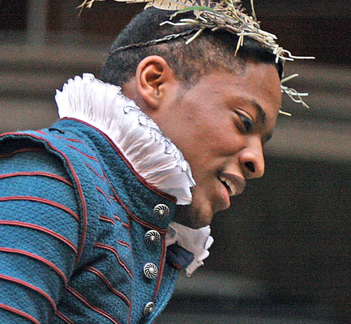


WHOOSH!
You are about to partake in a classic English Activity!
WHOOSH!

Slide 3




Slide 4






ROMEO AND JULIET WHOOOSH! Tips
Try and get a good feel for what the character is like!
Be passionate in your tone of voice and embrace your role!
Cheer each other on, clap and support those that are bravely stepping up to perform oto their best
Mystery Reward

Slide 5

Marcel

Slide 6

Clarice

Slide 7

Vanessa

Slide 8

Jayden

Slide 9

Sophie, Victoria

Slide 10
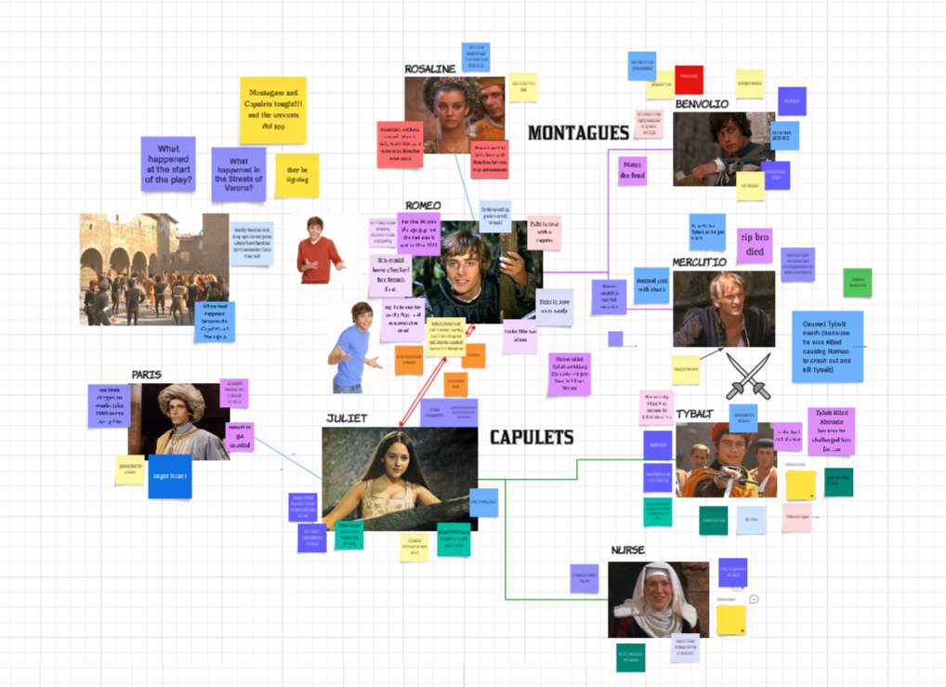
What happened in the play?
Head to the link to this lucid jamboard on Toddle after you’ve gotten into groups of three. Try your best to remember what facts you know about the character, or how other characters think and react to them in the play!
(Do not use the internet to search up answers)

Slide 11

Male Expectations
Fall in love with a women of higher social class, possibly married, so she is unattainable
Suffer continually from jealous thoughts
Perform deeds to make himself seem more worthy in front of his lady
Have faith in the power of God to help with the problem
Be consumed with passion, melancholy, grief
Be unable to eat or sleep
Make up verses and songs about the dilemma

Slide 12

Female Expectations
Only be chosen a suitably rich and powerful husband – an ally for the family
Spurn the man’s advances in order to preserve her honour and good name
Get married at age fourteen or fifteen
Have no say in the choice of husband
Be cold with the man in order to inflame his passion

